Slide 1
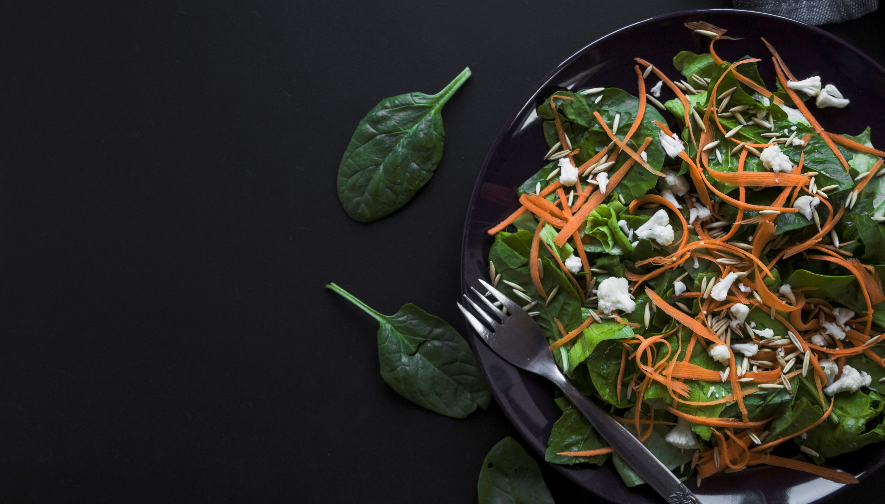
SUMEET & SHUBHAM PRESENT
DIGITAURANT
A DIGITAL RESTAURANT APP

Slide 2
PROBLEM STATEMENT
Contactless Transaction
Economical aspect
Contamination to several bacteria and virus and hygiene is big concern in many restaurants.
Sanitization, paper cost, physical database and some other factors are liable for increased cost which ultimately reflects in food prices.
Employment Opportunities
Deforestation
With more people shifting towards food home deliveries the employment for waiters are diminishing day by day.
A large number of trees are cut off everyday to produce papers, of which restaurant consumes a large part of it.
2

Slide 3
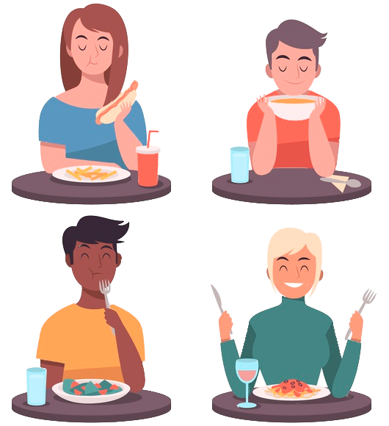
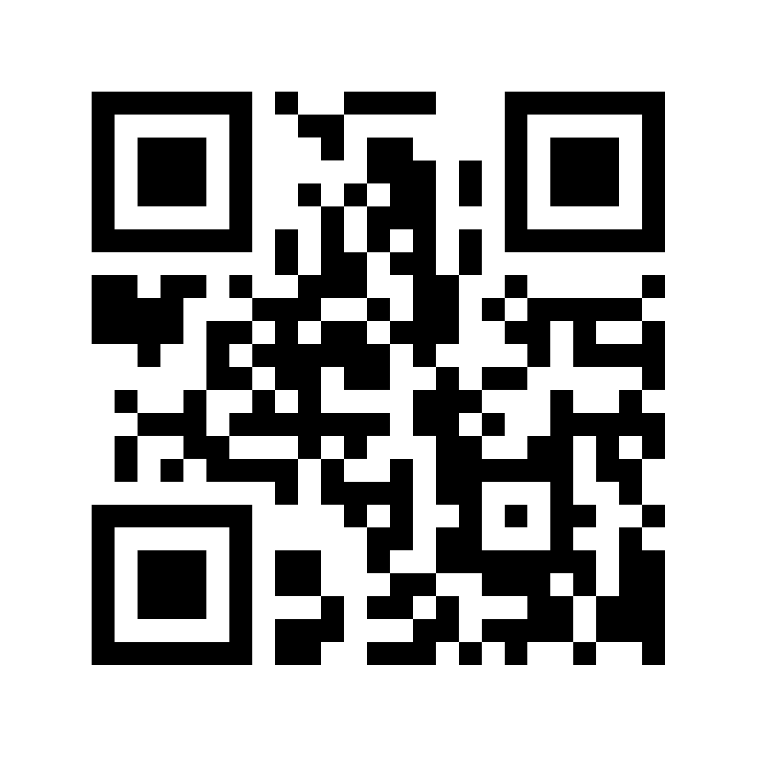

Introduction
With the world moving towards digital revolution eliminating the need to use papers as much as possible and also create a better environment to live in by doing so.
We with our app are working for the same, so the restaurants can go paper free to the max.
--------------------------------------------------------------------------------------------
With the App Customers will have the option to scan the QR code present on the table to start the ordering process.
With that done they’ll have to authenticate themselves with their phone number
3

Slide 4
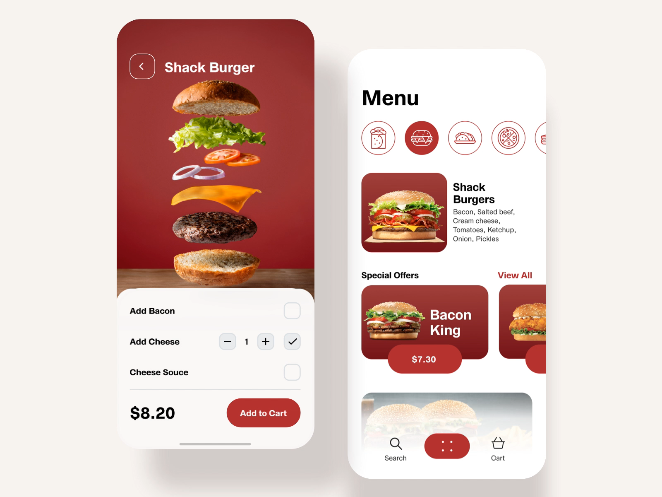
Introduction
Access to Menu Items will be there after authentication from which the user can order items.
4

Slide 5
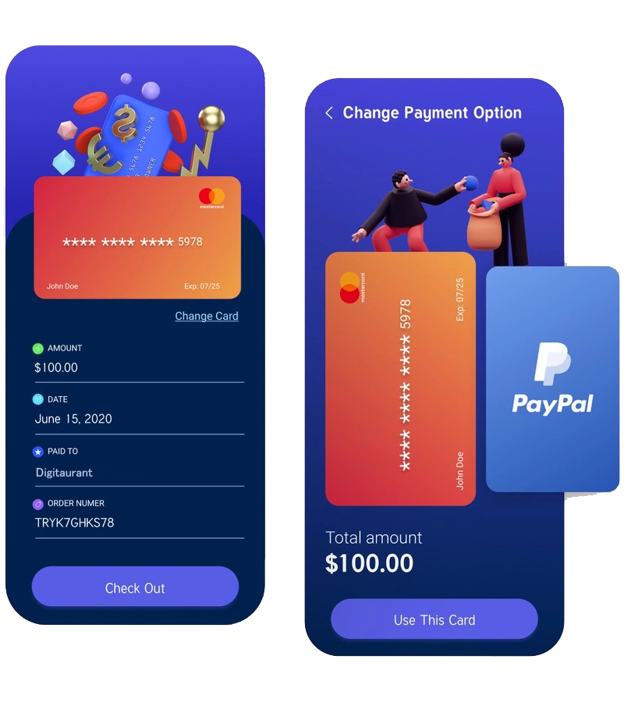
Introduction
After fulfilling his/her appetite the customer can end the session and pay for the food before leaving.
Specific options for Staff of the restaurant will also be there.
5

Slide 6
Objective & Scope
Digitaurant will have the necessary features to make the whole ordering and transaction process seamless.
User/Staff Authentication
Food Menu
User/Staff login will be there for account/session creation.
01
02
Dynamic Food Menu will be present according to available items.
Popular Options
Past Orders
03
04
Popular/Most Ordered foods will have another section.
Once account is created for a user he/she can have access to his/her previous orders.
A treat to your appetite
6

Slide 7
Objective & Scope
Digitaurant will have the necessary features to make the whole ordering and transaction process seamless.
Time Management
Staff Details
Customers will have the option to know whether there are tables available in the restaurant from the app only.
05
06
Details of the Restaurant’s chefs, staff members will be there in the database.
A Description page will also be there.
Session Based Ordering
Digital Transaction
07
08
Option for ordering more items after consuming one already ordered will be there for customer’s convenience.
Options for multiple Transactions modes will be there such as UPI/card/wallet payment to give a boost to Digital Transactions.
A treat to your appetite
7

Slide 8
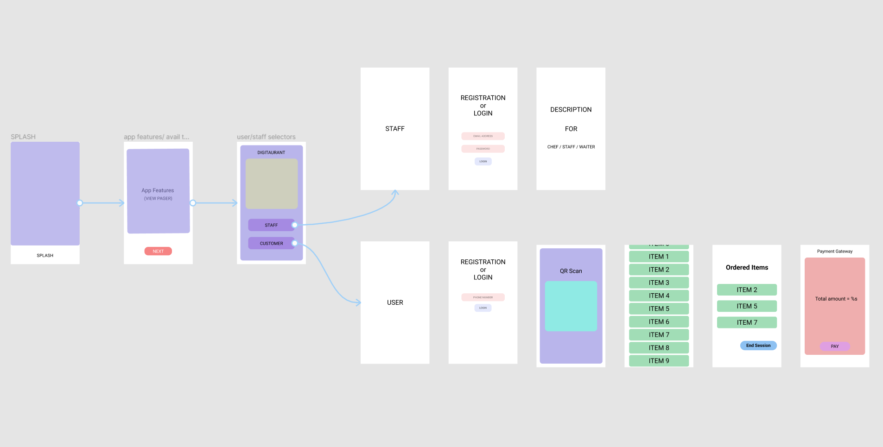
PROPOSED SYSTEM
8

Slide 9

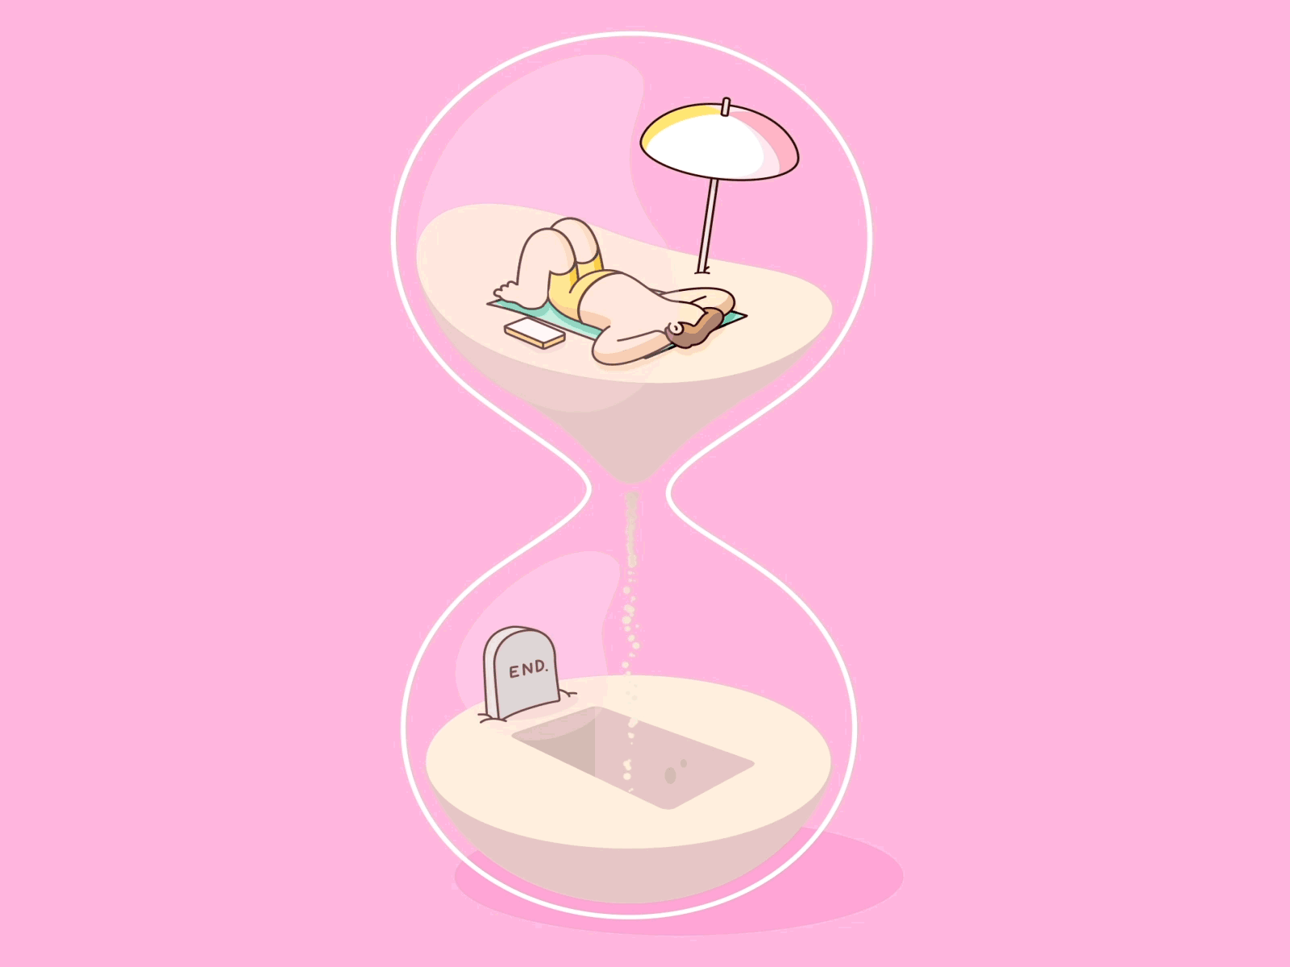

Feasibility Report
Reduced Paper Wastage
Time Management
Environment Friendly
Since all the whole food ordering cycle will be done through the app there will be no paper wastage.
Everyone knows Time is money, and our app will tell you before hand if there is seat available in restaurant or not so you can skip coming here.
Since a lot of paper is saved along with fuel of vehicles, the app will put an impact towards an eco-friendly environment.
9

Slide 10
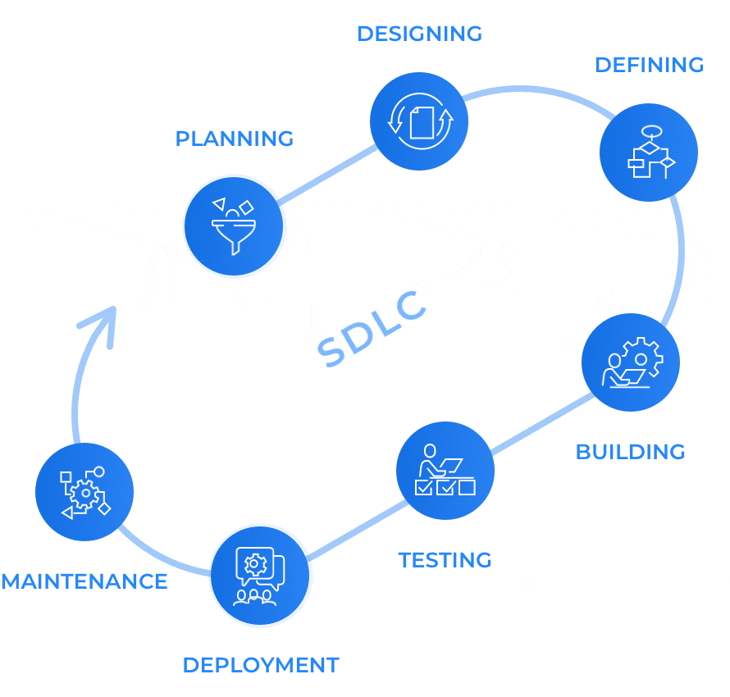

Slide 11
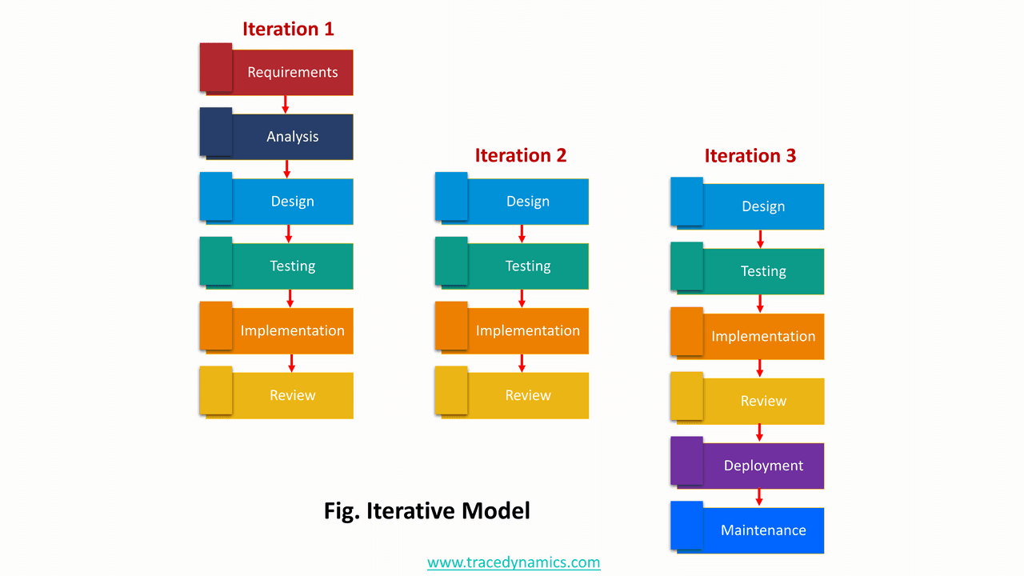
11

Slide 12

In our application user has to provide some details.
Functional Requirement
Phone Number
Phone number is required for user authentication.
Location Access
Phone’s location is needed for checking whether the customer is actually in restaurant or not.
Internet Access
Internet connection must be there in the smartphone to carry out the whole transaction.
12

Slide 13
Application will have some non-functional requirements
Non-Functional Requirement
Availability
App will be available on play store for everyone’s usage and access.
Usability
App will have simple and clean UI for easy understanding.
Security
Users and staff details will be safe within our app.
Maintainability
Feature updates and maintenance will also be done for the app.
13

Slide 14
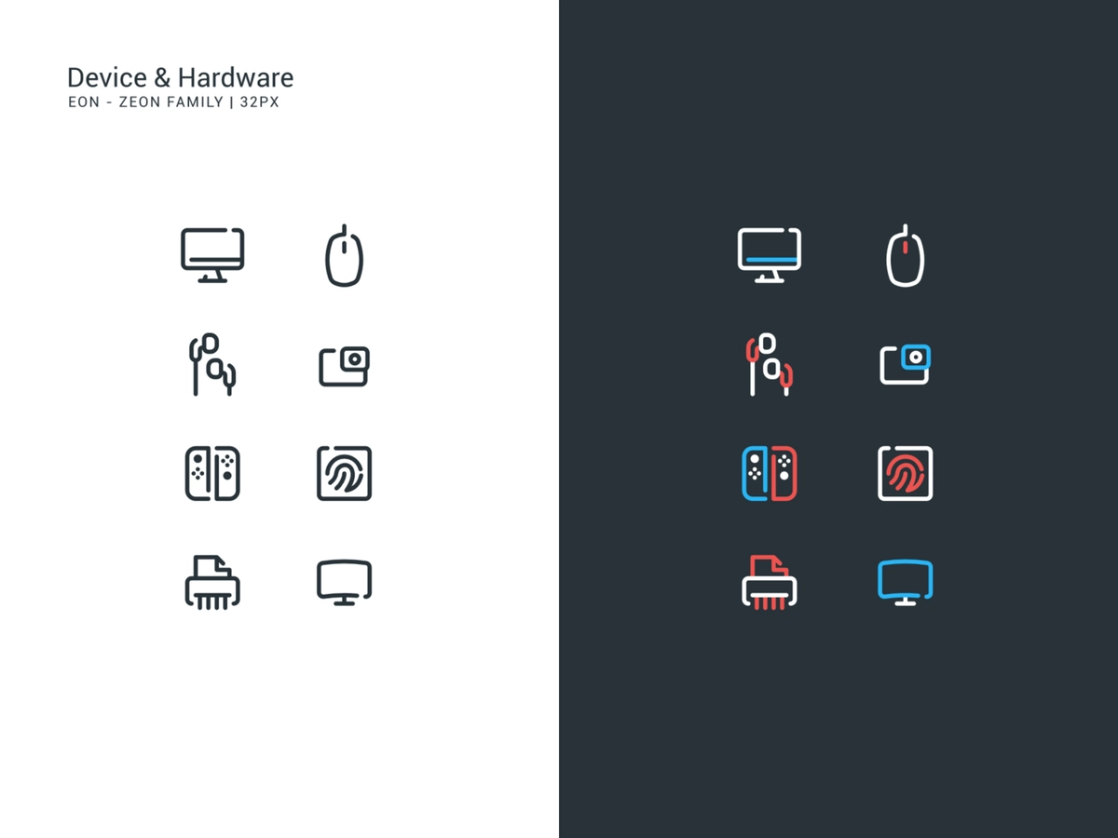
Hardware Requirement
Client
Developer
Processor : 1200Mhz processor or better.
RAM : 2GB or higher.
Device : Basic Sensors, Features Wi-Fi, GPS, Camera.
Processor : 1200Mhz processor or better.
RAM : 2GB or higher.
System’s : Quad core or higher
Processor
System’s : 8GB or higher
RAM
Device : Sensors, Text to Features Speech, Bluetooth,
Wi-Fi, GPS, Camera.
01.
Quality Choices Ingredients
Vivamus elementum semper nisi. Aenean vulputate eleifend.
14

Slide 15
Software Requirement
Client
Developer
Mobile’s OS : Android 7 or higher
Display : 720p minimum
Operating : Windows 8 or System higher
IDE : Android Studio (latest version)
Database : SQLite and Firebase
Mobile’s OS : Android 7 or higher
Document : MS-word,
Tools MS-PowerPoint
01.
Quality Choices Ingredients
Vivamus elementum semper nisi. Aenean vulputate eleifend.
15

Slide 16
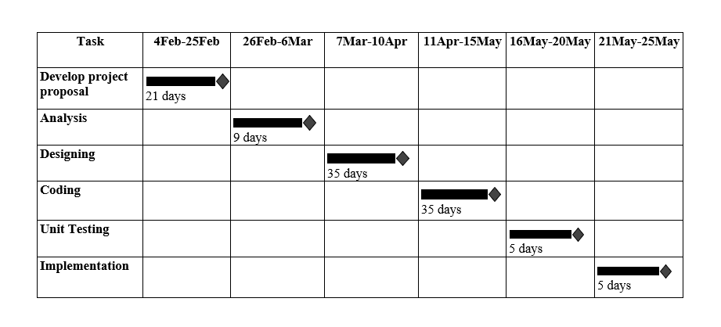
Project Schedule(Gantt Chart)
A Gantt chart is popular type of chart that illustrates a project schedule. Gantt Chart illustrates the start and finish dates of the terminal elements and summary elements of a project. Terminal element and summary comprise the work breakdown structure of the project.
16

Slide 17
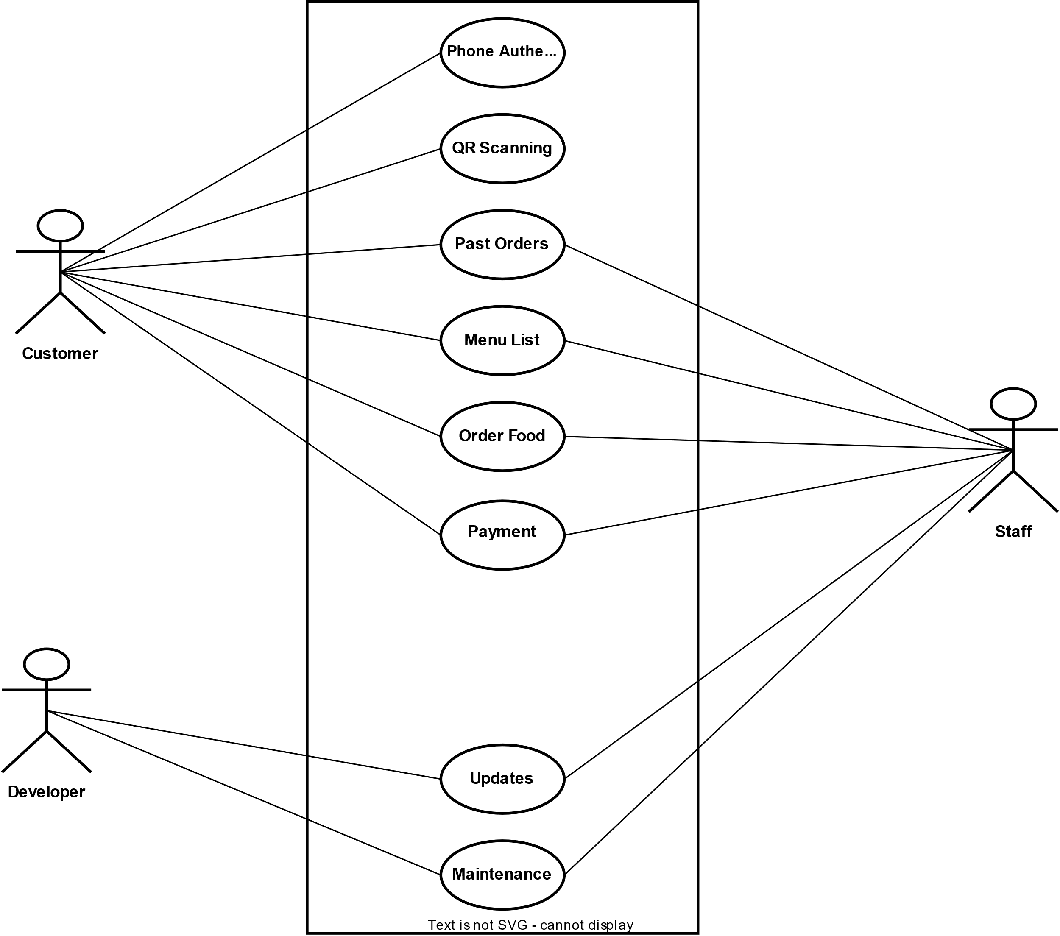
Use Case Diagram
17

Slide 18
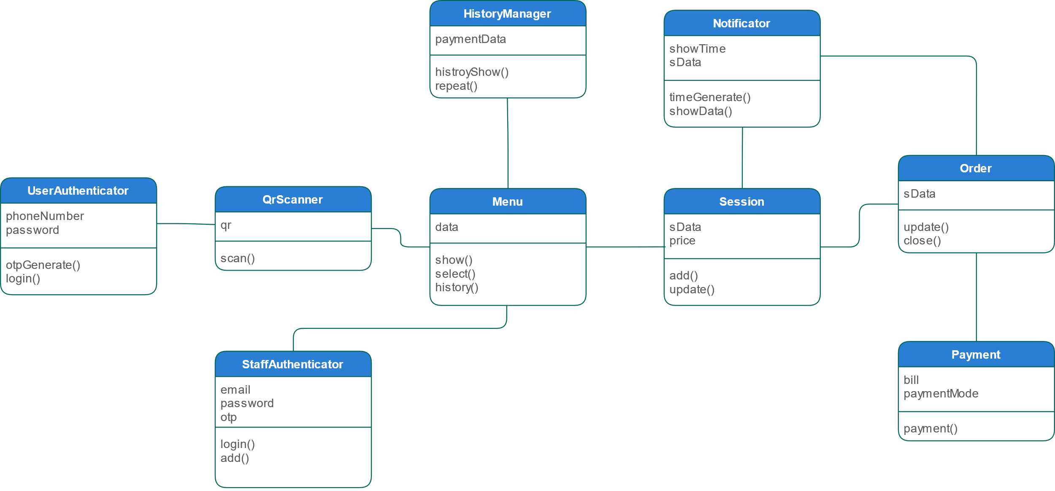
Class Diagram
18

Slide 19
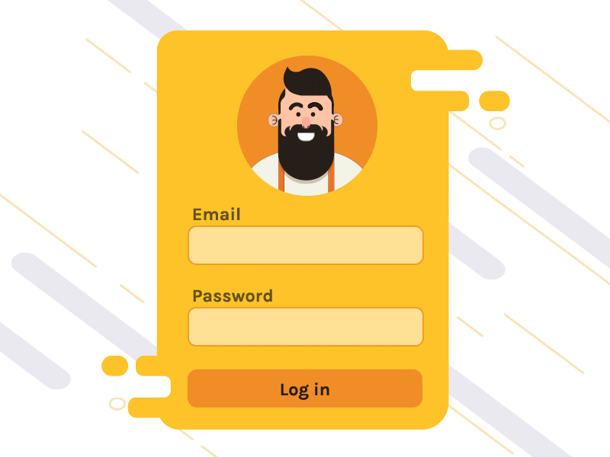
Module Description
QR Scan System
Customers can scan the QR Code present on the table to gain access to the app if not already installed
User Authentication
The user authentication system is an login system for the user. The user login using phone number authentication so as to make the process faster
Staff Authentication
Staff Authentication system allows manager to add new staff with registration process with email and password or the login system for the already existing staff.
19

Slide 20
Module Description
Payment Gateway
Satisfying his/her appetite the customer then can choose to close the session by making payment for the ordered items which will redirect him to the payment gateway.
View Management System
The whole layout, activities and fragments comes under this section which allows the communication between the activities and fragments.
20

Slide 21

Module Description
Cloud Menu Manager
Menu in the app will be fetched from the cloud database only showing the available items on a particular time of the day.
Session Creation System
Once the user gains access to the menu and orders something a session will be created for the same having information of the table number, date, time and item of the order.
Notification System
After placing the order the customer will get the notification for the approximate wait before the item is served to him. Also a notification is sent to the staff about the order placed by the customer.
21

Slide 22
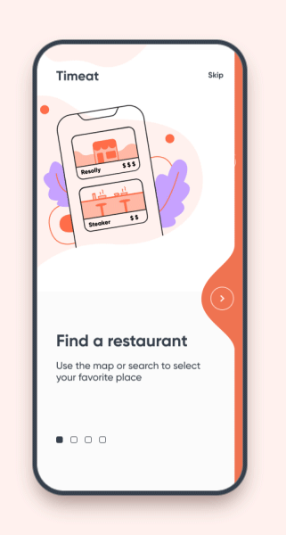
Module Description
Ordering System
After the session is created the customer can order anything available in the menu until he chooses to close the session.
Order History Management
Once the account is created for a user he has access to his order history for the restaurant and can also repeat the same order another day from there only.
22

Slide 23
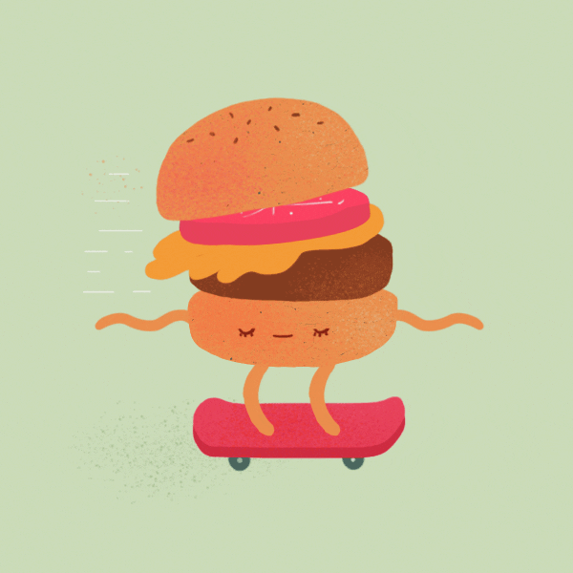
Conclusion
In this Digital Era where the world is moving towards digitizing everything possible, our app will make sure that everything done in the restaurant will be paperless and in digital mode.
The app is focused on eliminating the need to use paper as much as possible and provide comfort to customers in every way possible.
23

Slide 24


